Slide 1
ECE 4304
Lab #5
Ahiezer Lopez
Joe Si
Sander Zuckerman

Slide 2
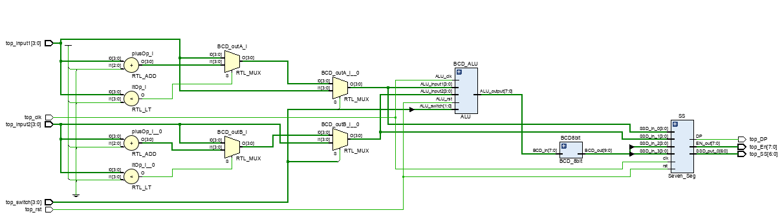
Contributions
Multiplier/Connecting
Joe Si
Adding/Subtracting
Ahiezer Lopez
Multiplier/ Connecting
Sander Zuckerman

